Slide 1
HudsonAlpha BioTrain Computational Bootcamp

Slide 2
Computer Setup
https://james-lawlor.github.io/biotrain-2023/
Setup Bash
(Windows) Download Git BASH http://www.gitforwindows.org
(Mac/Linux) Included. Open the “Terminal” application.
Get data-shell.zip from SW Carpentry http://swcarpentry.github.io/shell-novice/setup.html
Install R https://cran.rstudio.com/
Install RStudio Desktop https://www.rstudio.com/products/rstudio/download/#download
Download r-novice-inflammation data

Slide 3
Today’s Agenda
Belle preaches at you about why Bioinformatics is important
Belle tells you a bit about her research
Programming with R
Analyzing Biology Data
Writing Functions
Using For Loops to Analyze Multiple Data Sets
Getting Programming Help

Slide 4
Belle’s intro to comp bio

Slide 5


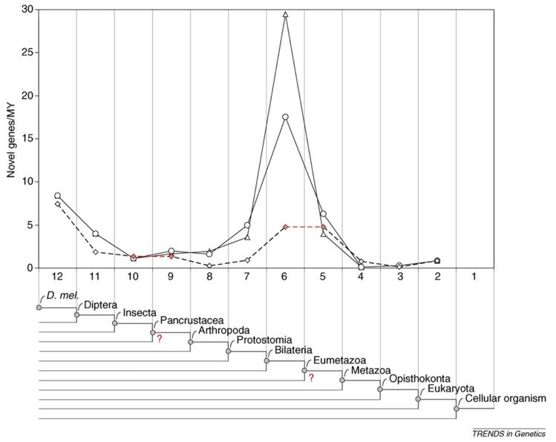

About Belle Moyers
B.S. Biological Sciences, B.A. Psychology, Purdue University
PhD Bioinformatics, M.A. Applied Statistics, University of Michigan
Graduate thesis: On Gene Age, Gene Origins, and Evolutionary Trends

Slide 6
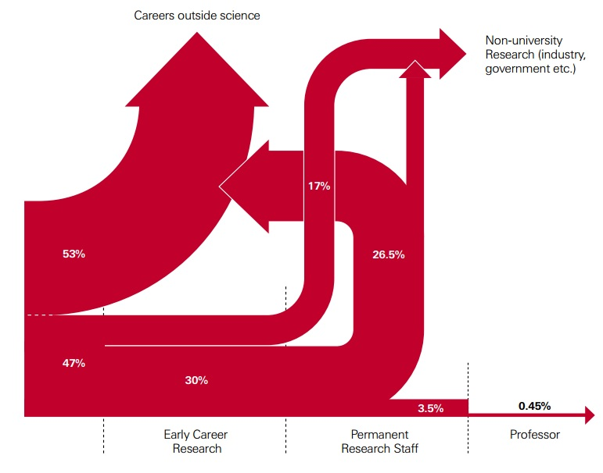
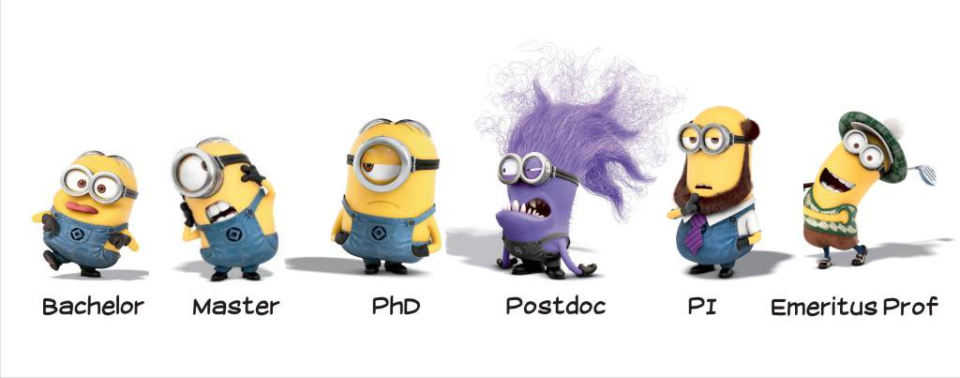
Postdoctoral Fellow and Beyond
HudsonAlpha Institute for Biotechnology, 2017-Present
Computational and Statistical analysis of genomic data for gene regulation.
Analysis of genomic variants in disease.
http://blogs.nature.com/naturejobs/2014/10/03/the-postdoc-decision/

Slide 7
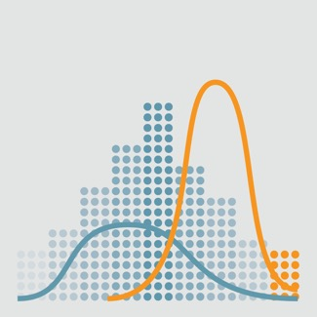
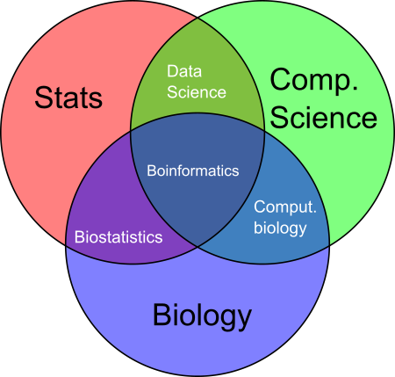
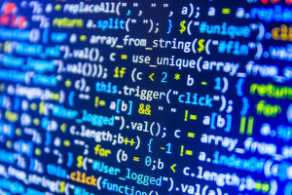
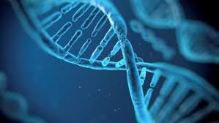
What is Bioinformatics?
“The science of collecting and analyzing complex biological data such as genetic codes.”
Day-to-day, bioinformatics is mostly coding, statistical analysis of biological data, and data visualization.
Work with biological data and other biologists to:
1) form conclusions
2) make new predictions / hypotheses to be tested
3) code computational tools for the biological community.

Slide 8
Why Bioinformatics
There’s just too much data.
Many modern biological problems can’t be solved by hand.
Computational approaches are necessary to analyze enormous amounts of biological data.

Slide 9
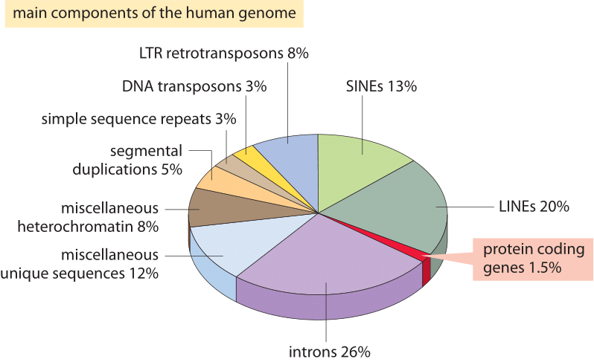
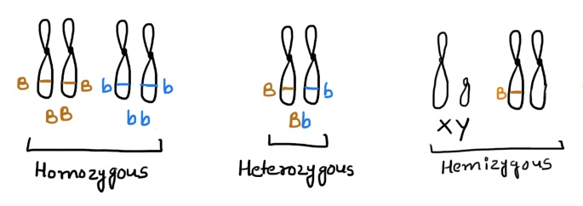
Why Bioinformatics?
Let’s take a look at a single human genome…
~3 billion nucleotides. Two copies– mostly identical.
~22,000 protein-coding genes. ~1.5% of the genome (45 million nucleotides).
The remaining ~98.5% controls gene regulation, genome shape, chromatin, etc.

Slide 10
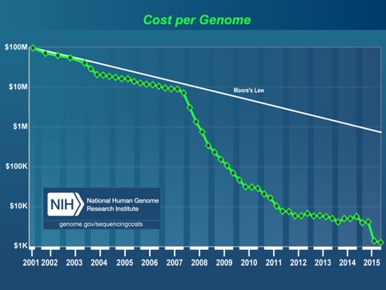

Why Bioinformatics?
The cost of sequencing has rapidly decreased over the past decade, hitting the “$1000 genome.”
The NIH “All of us” Initiative has made it a goal to sequence 1 million genomes, each with ~3 billion nucleotides. (recently released the first 250k genomes)
Sequencing of more individuals can help humanity in several ways.
Better understanding of disease causes and risks.
Better understanding of diversity and responses to medicine.
https://allofus.nih.gov/news-events/announcements/all-us-research-program-makes-nearly-250000-whole-genome-sequences-available-advance-precision-medicine

Slide 11
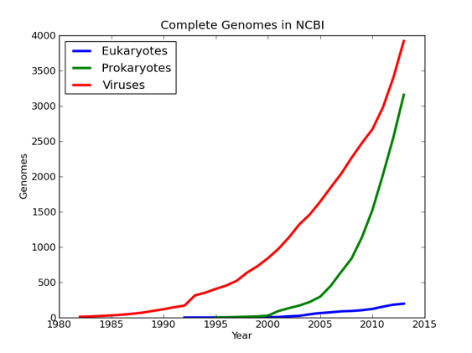
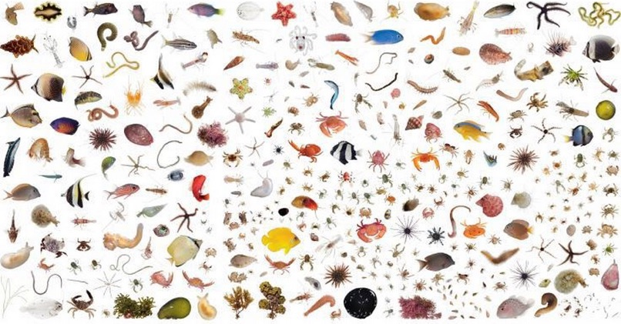
Why Bioinformatics?
~10,000 different species have sequenced genomes.
But there are an estimated 8.7 million species on the planet
Better understanding of molecular evolution
Potential sources of medicine
Implications for conservation efforts
Better understanding of what genetic elements can help species to survive in difficult environments.

Slide 12

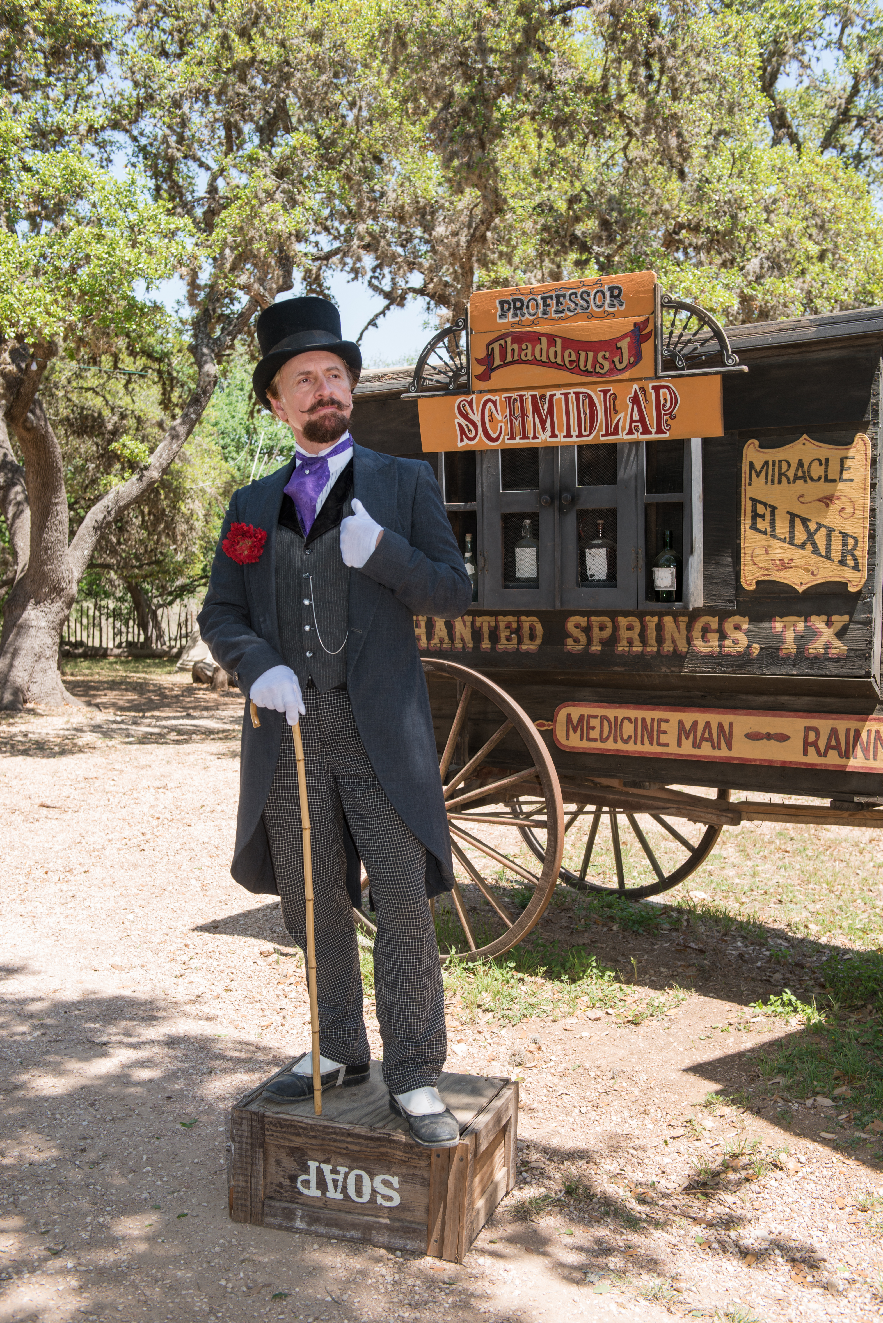
Ethics in Bioinformatics
if ( action != ethical ) {
print(“Don’t do that!”)
}
Ethical and social areas increasingly intersect with biology and bioinformatics

Slide 13
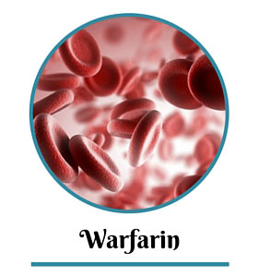
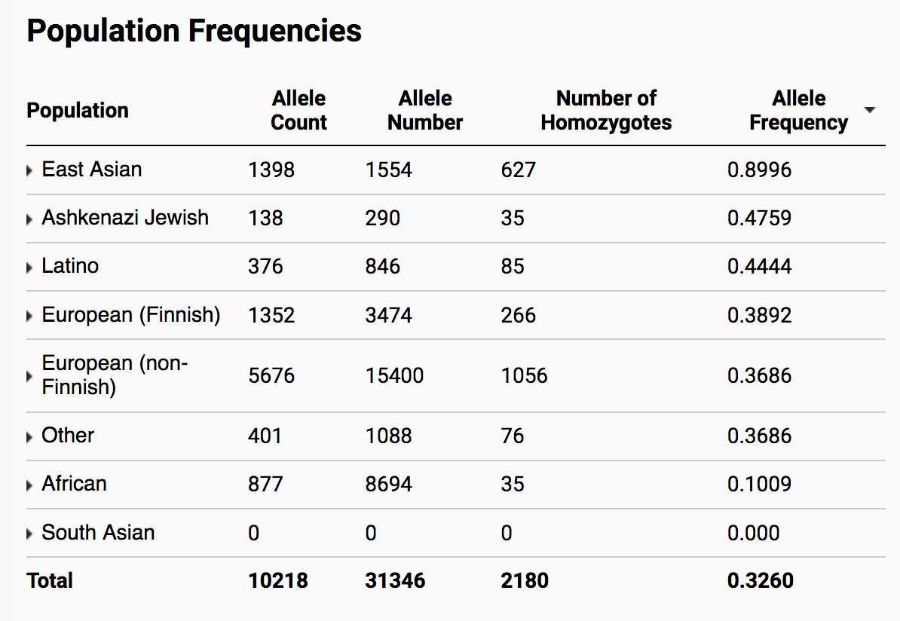
Representation – serving a broader community
For a particular medical finding, how sure can we be that the results are true across different populations? Men and women? Various racial and ethnic groups?
Different genetic background can have implications for the effects of medicine, symptoms of disease.
It’s possible that a variant that is rare in one population is very common in another.

Slide 14
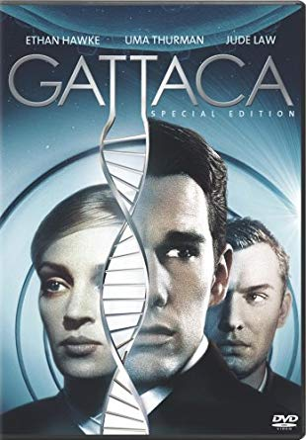

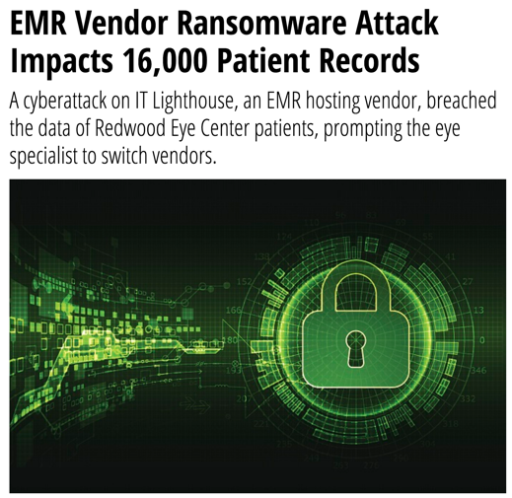
Protection – once the data exists, how do we keep it safe?
How can we protect a person’s genetic data?
Who should have access to a person’s genetic data, and how can we help ensure that only those people have access?
Should genetic and medical data be available for research? How can we de-identify information to protect people?

Slide 15
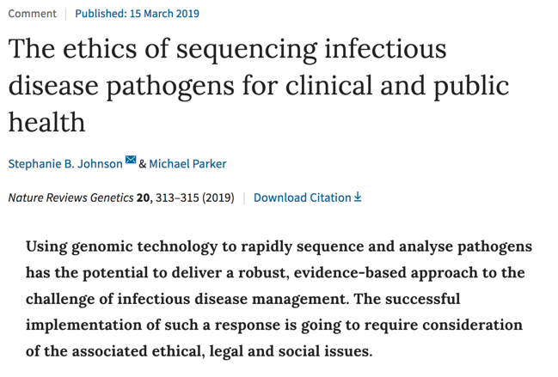
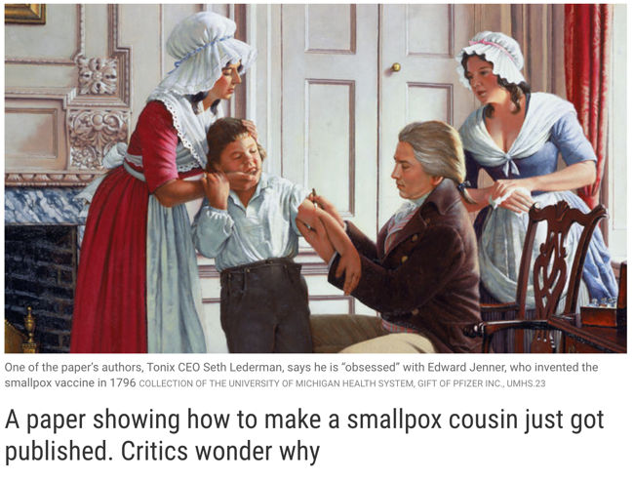
Public Safety – how do we protect and use data to keep people safe?
Should we restrict public access to the genome sequences of dangerous organisms?
If so, how can data be stored to both protect the public and still allow research to be performed?

Slide 16
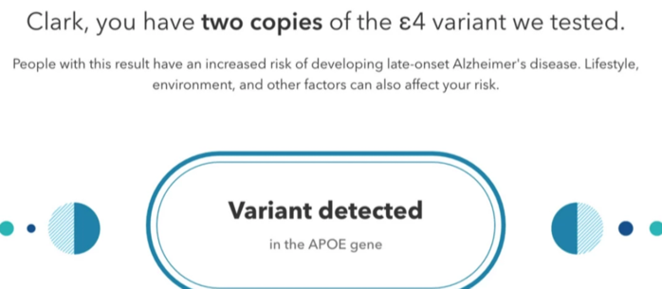
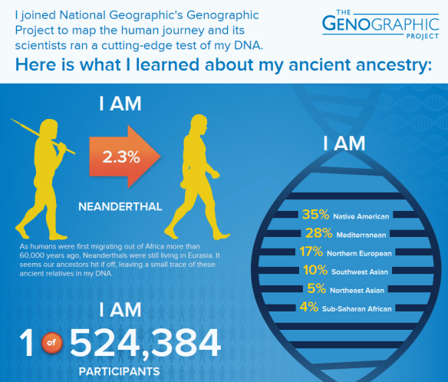
Use and Presentation of Data – how can we avoid misrepresentation and misuse?
How can we avoid misleading patients or doctors about the interpretation of bioinformatics results?
Disease risk?
Accuracy/interpretation of ancestry estimates?
Misappropriation of scientific findings (Content Warning- the thread discusses white supremacists, their malicious misuse of genetics research, and the scientific community’s failure to fight them) https://twitter.com/JedMSP/status/1526985711282446337

Slide 17
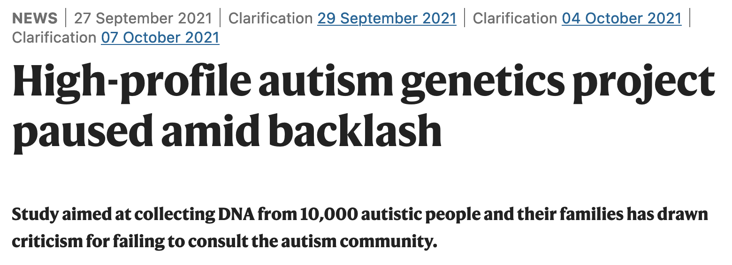
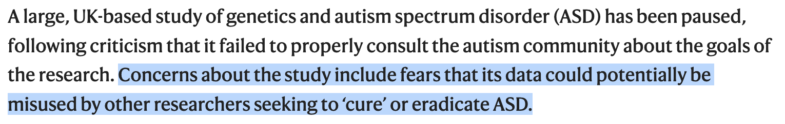
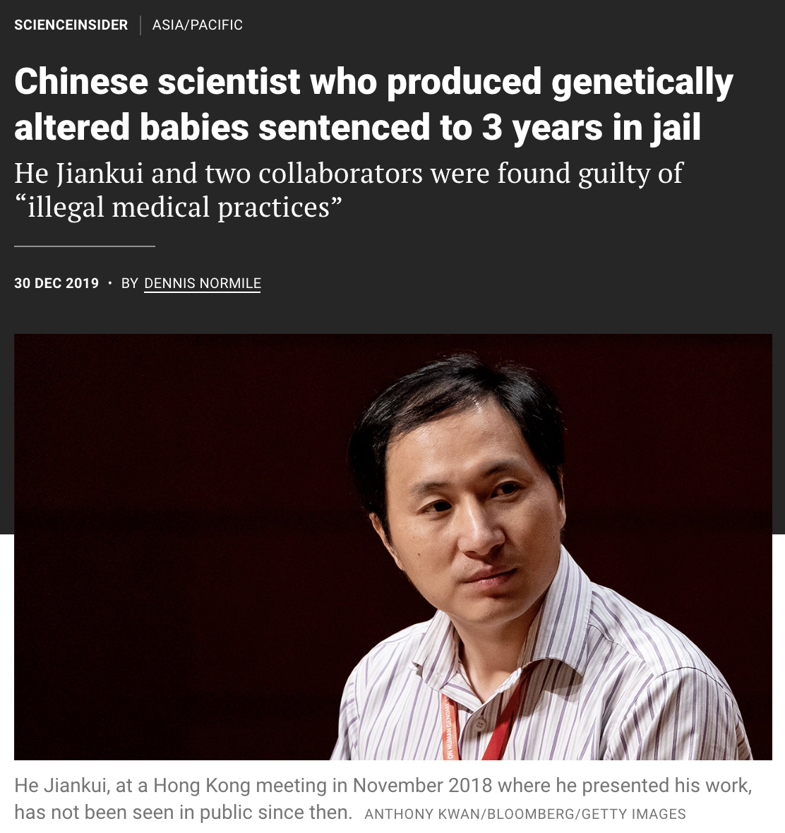
Are there some topics that we should avoid researching?
Given the history of eugenics in biology, are there certain topics that we should avoid researching?
The Genetics of Intelligence
The Genetics of Autism
The Genetics of LGBTQ+ populations
Can we avoid accidentally learning about these?
Can we research them ethically?
Are there safeguards to prevent their misuse?

Slide 18
Working in science, it is your responsibility to consider ethical issues in ANY project you work on. Whether you are the Professor, a grad student, an intern, a marketing rep, etc.
It’s easy to downplay computational biology as just analyzing data.
The analyses you are willing (or not willing) to run matter.
How you frame the results matters.
The tools you create and how they might be used (or misused) matter.
If you are aware of someone misusing your work, you have a moral obligation to speak out.

Slide 19
Comp bio in the Myers lab

Slide 20
What do I do?
Genetic Variation
Change in TF-DNA associations
Change in Gene Expression
Disease
eQTLs
Gene- or genome-wide association

Slide 21
Gene Regulation

Slide 22
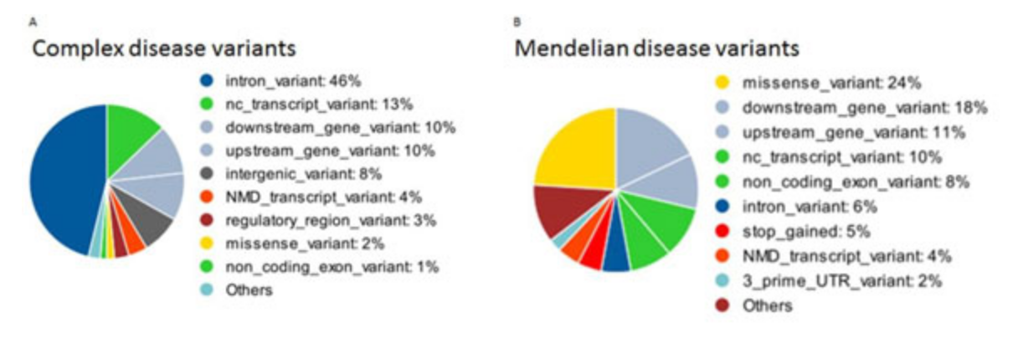
Disease variants outside of the protein-coding region
The “easiest” (still very difficult) disease variants to understand are those that occur in the protein-coding region of a gene.
But MOST disease-associated variants do not occur in the protein-coding region.
>95% of diseases are non-Mendelian (Complex)
About 6% of complex disease variants are in protein-coding regions.
<5% of diseases are
Mendelian
About 33% of Mendelian diseases have variants in protein-coding regions.
https://www.ncbi.nlm.nih.gov/pmc/articles/PMC4480828/

Slide 23
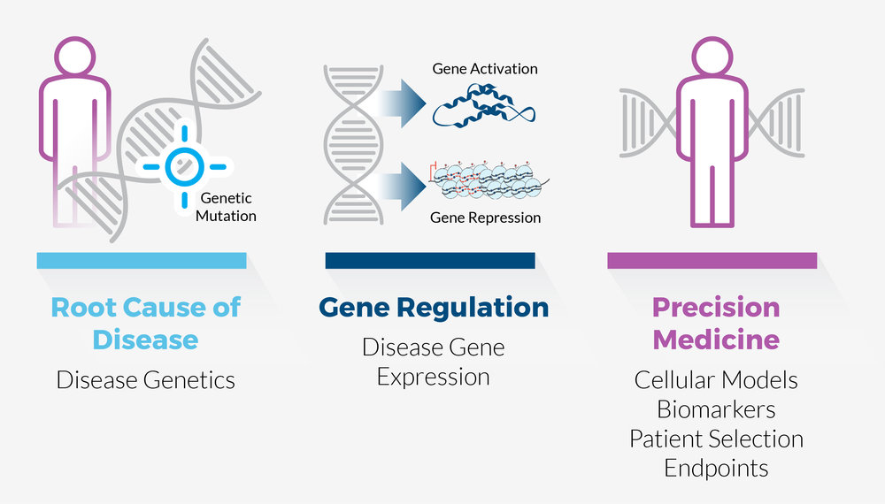
Disease often involves change in gene expression
One kind of non-protein-coding variant are gene regulatory variants.
Understanding how genes are regulated can lead to novel insights about disease.

Slide 24
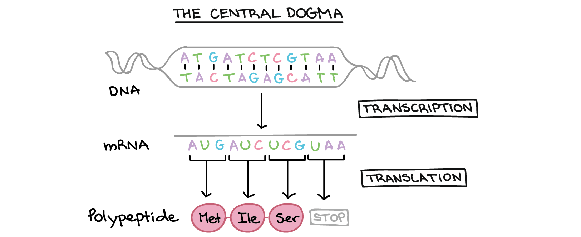
Transcription Factor Binding
The ”central dogma” of molecular biology shows the derivation of RNA from DNA and Protein from RNA.

Slide 25
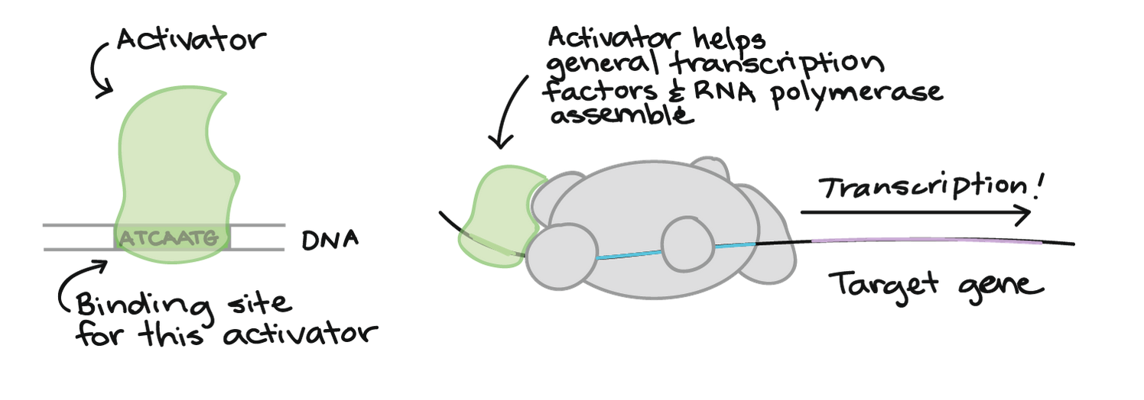
Transcription Factor Binding
For RNA to be produced from DNA, you need activating Transcription Factors (TFs) to bind to DNA.

Slide 26
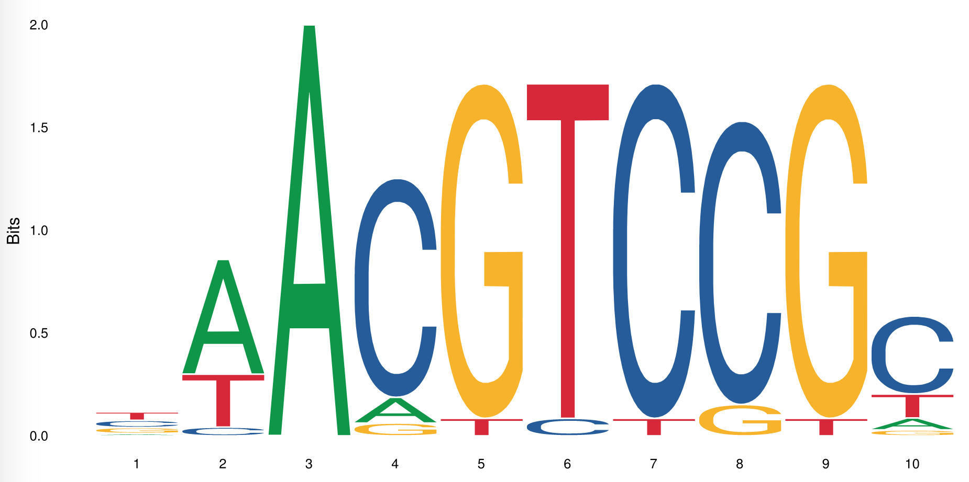
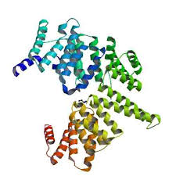
What makes TFs bind?
What makes a TF bind to some places in DNA but not other places?
Many TFs bind specific DNA sequences, which can be represented by DNA sequence motifs.
If this motif sequence is destroyed with a mutation, it may stop a TF from binding DNA

Slide 27
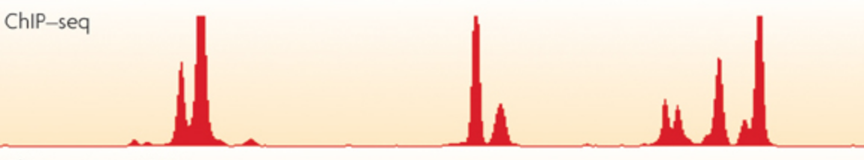
But *which* mutations?
There are an astronomical number of mutations that are possible in the genome!
How do we know which ones influence TF binding? How do we narrow it down?
First we identify which parts of the genome are bound by a given transcription factor: ChIP-seq.

Slide 28
Investigating regulatory sequences
Given the locations of bound TFs, what can you do with that information?
Models of TF binding
Identifying allele-biased binding
Identifying effects of binding

Slide 29
Models of TF binding

Slide 30
Models of TF binding
We can compare bound sequences to unbound sequences and look for differences.
Can you determine any patterns from the data below?
>BoundSequence1
AAAAAAACGA
>BoundSequence2
AAAATAAAAA
>BoundSequence3
AAAAAAACAA
>BoundSequence4
AATAAAAAAG
…
>UnboundSequence1
GGGGGGGGGG
>UnoundSequence2
AAAAGAAAAA
>UnoundSequence3
AGAAGGATAG
>UnoundSequence4
TTAGGATTGAT
…

Slide 31
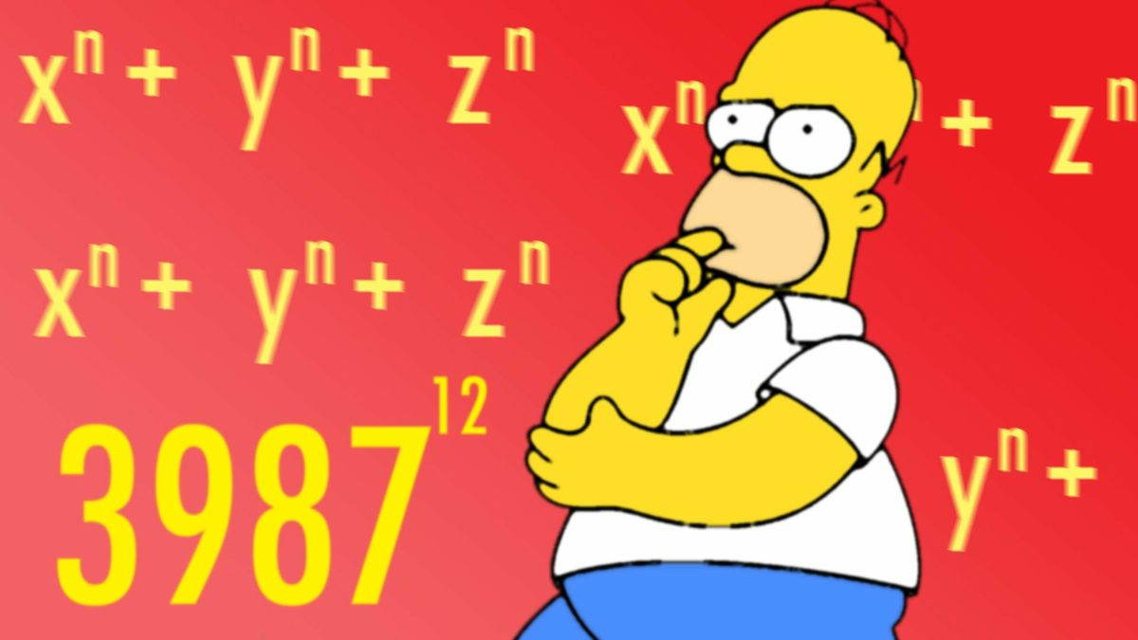
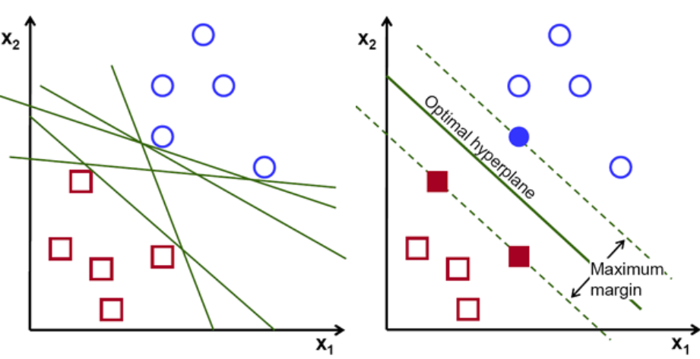
Don’t do it manually– Use Bioinformatics!
Of course, visually inspecting sequences is unlikely to detect real patterns. And if it does, it’s extremely time-consuming!
Instead, we use math!
From input data, we can create a model called a support vector machine.
Bound Sequences
Unbound Sequences
Input Data
MATH!
Models of TF binding

Slide 32
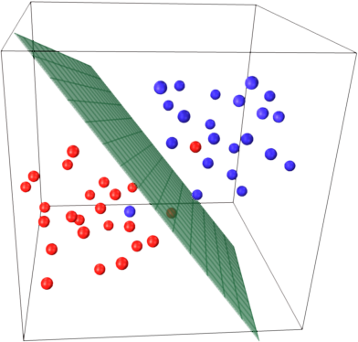
Using this model
This mathematical model can then be used to compare new sequences and determine how likely it is a TF would bind them.
This is one way of determining how a regulatory variant might impact TF binding. This, specifically, is a Support Vector Machine (SVM).
Bound Sequences
Do these two sequences fall on different sides of the dividing line?
>NativeSequence
GATTACA
>MutantSequence
CATTACA
Unbound sequences

Slide 33
Sequence representation models
In an SVM, sequence is projected into multi-dimensional space in an attempt to separate bound and unbound sequences.
There are other models which are more interpretable visually, including motif-finding algorithms and sequence-based neural networks.

Slide 34
Allele-biased binding

Slide 35
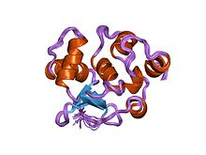
Allele-biased binding
In-vivo binding
ChIP-seq reads
Reference mapping
Mapping to donor genome
Binomial p-value: 2.5E-7
Binomial p-value: 0.83
 | Ref. Reads | Alt. Reads | Pvalue
Example1 | 30 | 2 | 2.5E-7
Example2 | 10 | 12 | 0.83

Slide 36
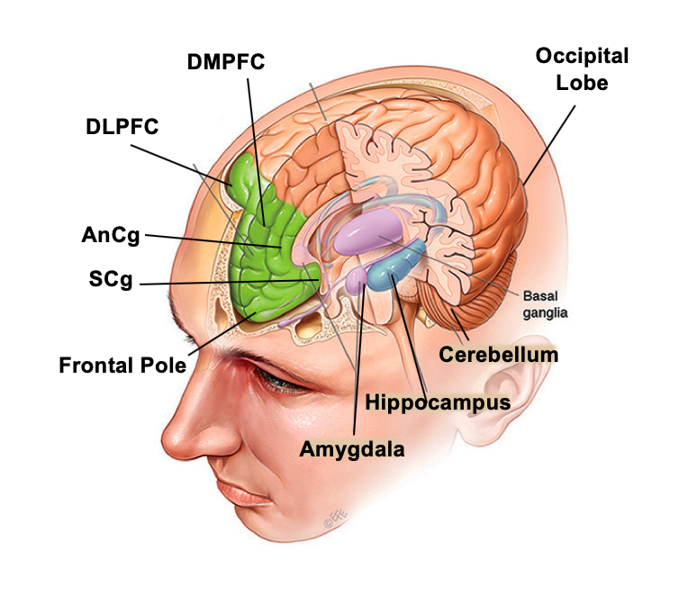
Data Sources and results
Two people who donated their body to science.
~960 ChIP-seq experiments in different human brain regions.
 | Donor1 (% vars) | Donor2 (% vars)
Number of variants impacting binding | 146,383 (4.82657%) | 155,962 (5.073138%)
Total Var*TF interactions | 320,368 | 354,117
Mean TFs/variant | 2.18856 | 2.270534

Slide 37
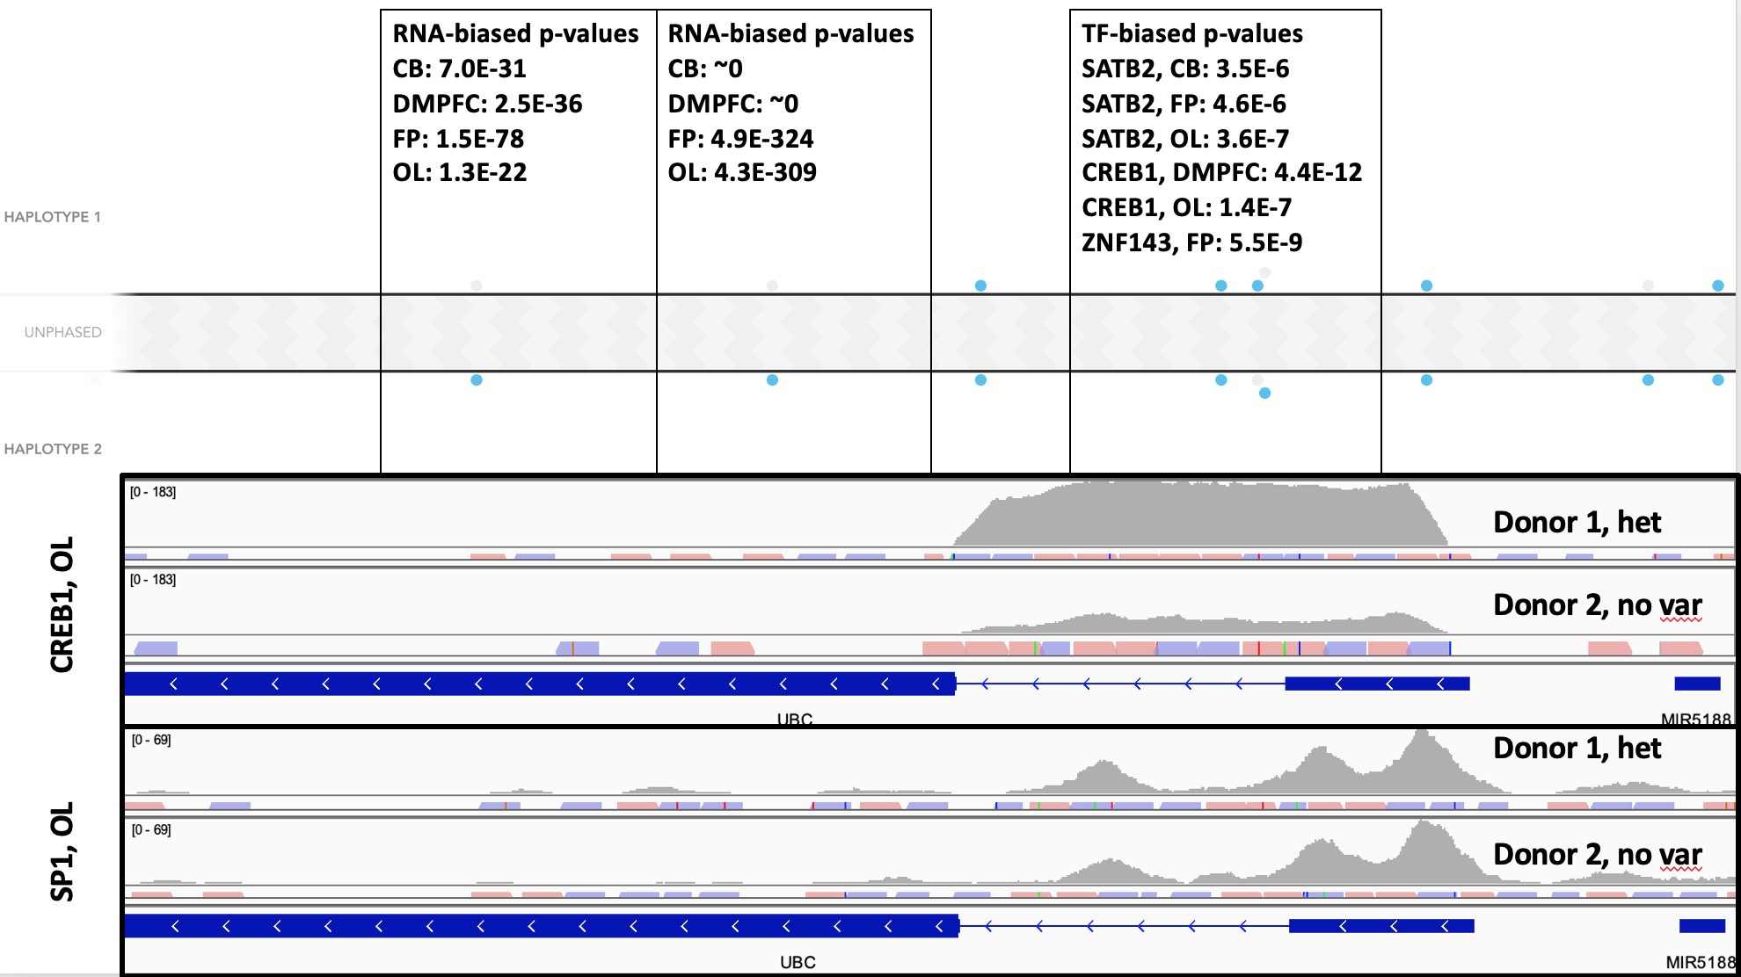
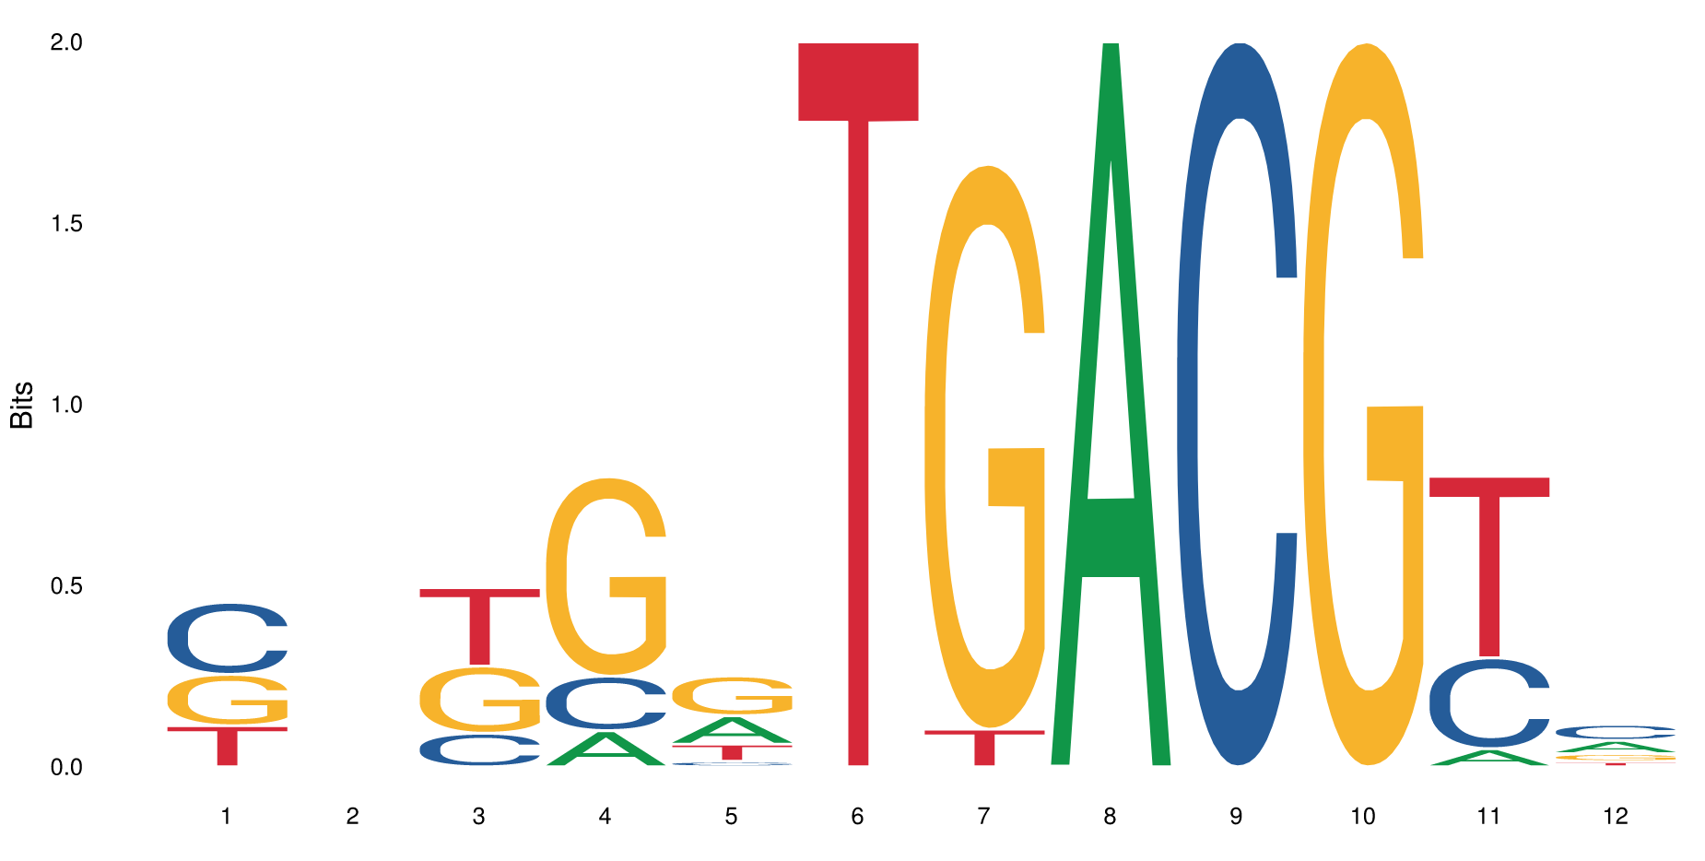
Impacting Expression
Variant
GTTCTTGACGCTG
GTTCTTGGCGCTG
Reference
Hundreds of similar variants.

Slide 38
Effects of binding: Gene-expression relationship

Slide 39
Transcription Factor Binding
For RNA to be produced from DNA, you need activating Transcription Factors (TFs) to bind to DNA.

Slide 40
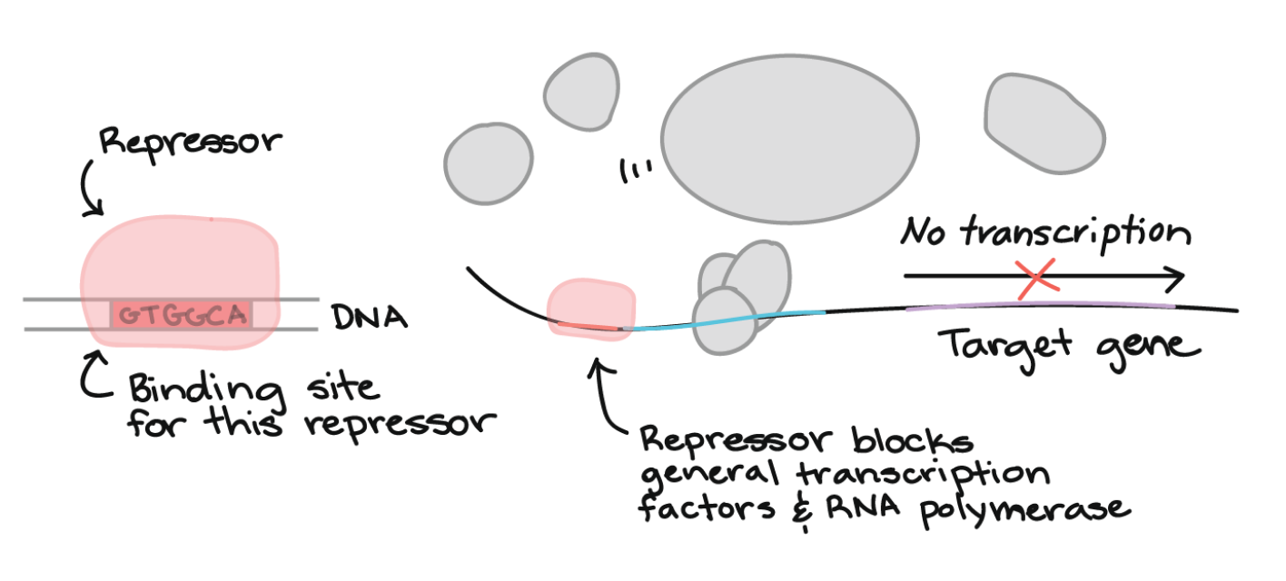
Transcription Factor Binding
There are activators *and* repressors.
Each TF might have a different function, and a different strength, depending on the context.

Slide 41
Teasing out TF effects from biological data
Ideally, we could test each TF individually.
In practice, this is very difficult.
But we have biological data from gene promoters that tells us expression level and all the TFs bound.

Slide 42
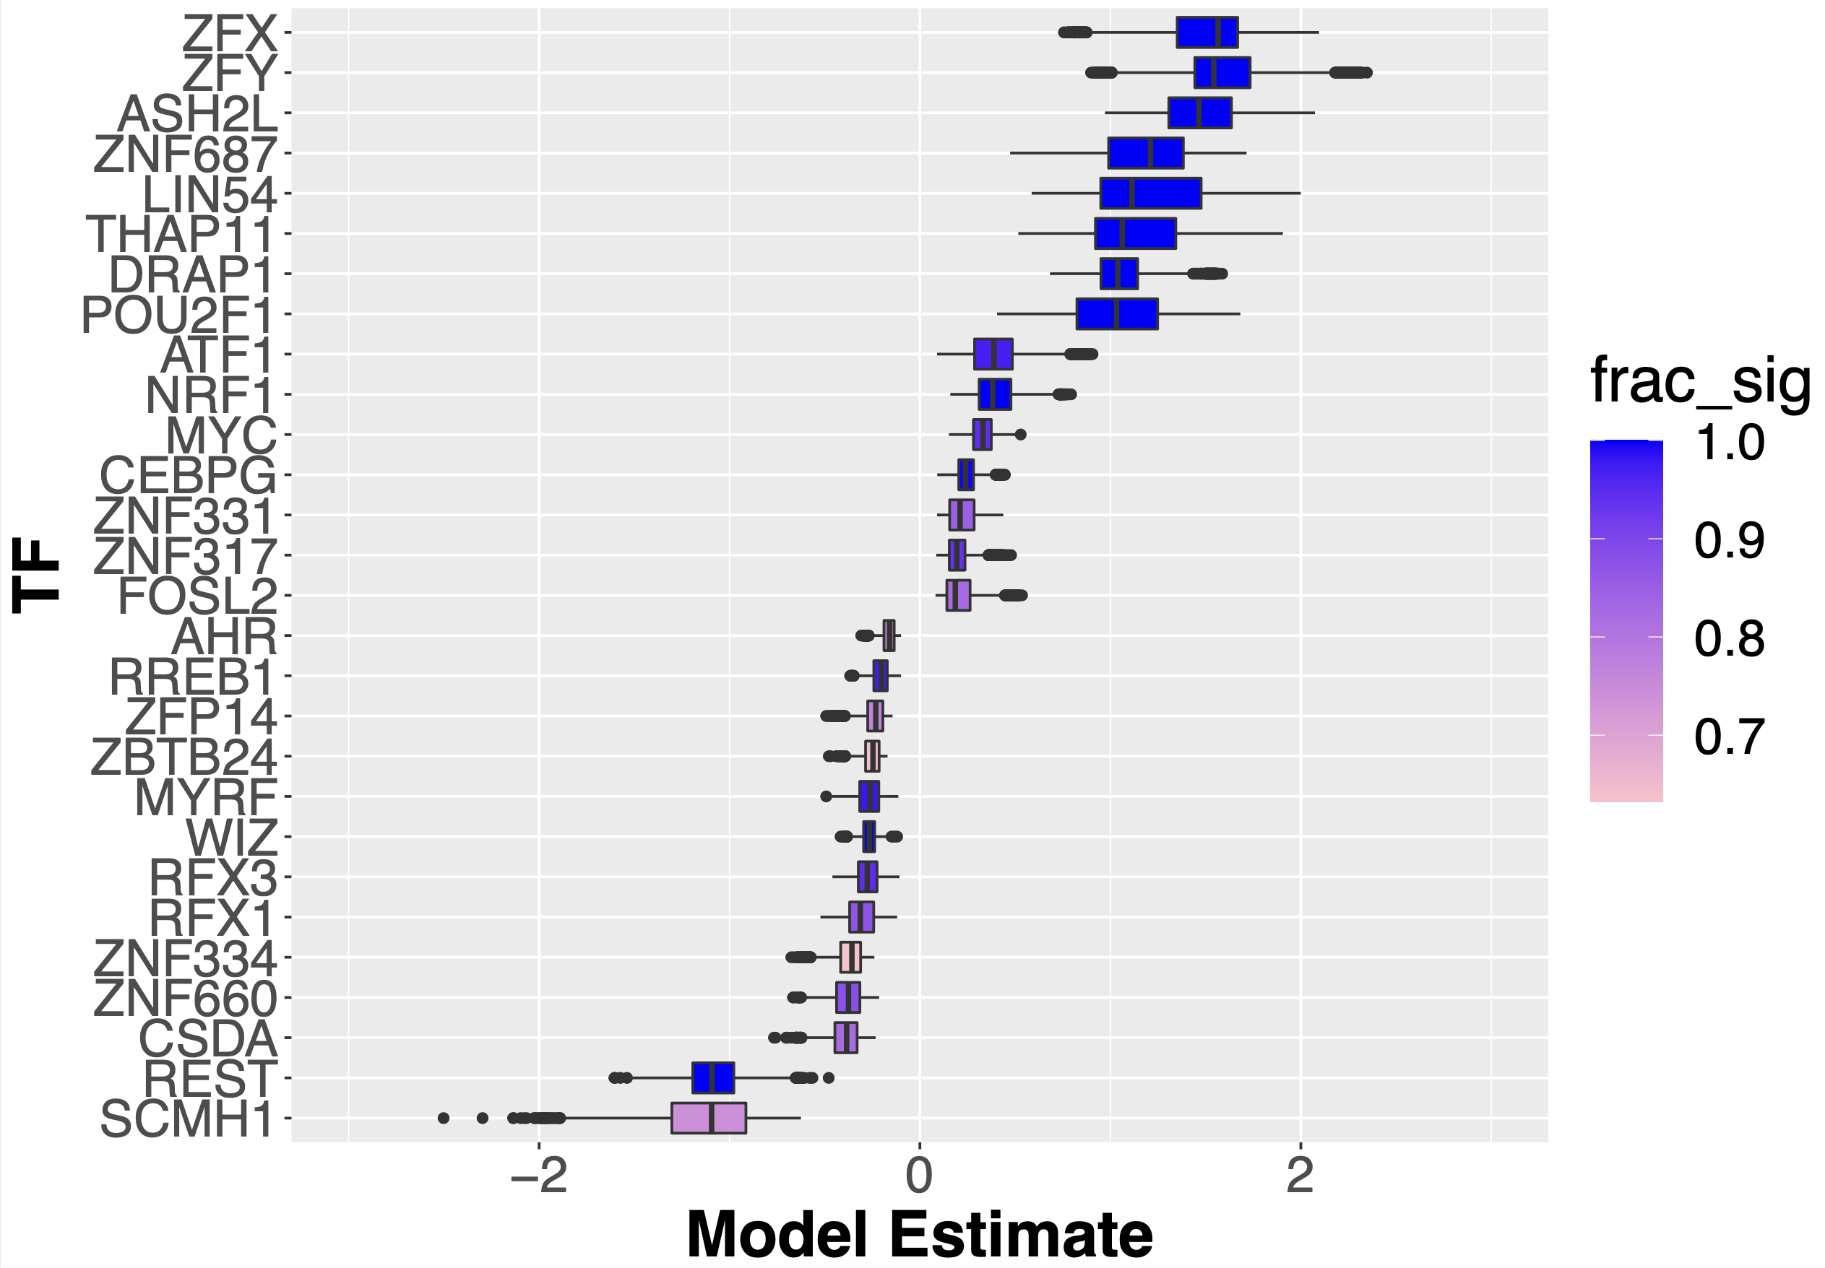
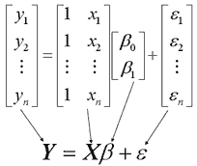
What is the function of a particular TF binding?
It can be very difficult to figure out the function of an individual TF.
There are 1600+ TFs, and their behavior can be context-dependent!
We can use linear modeling to generate hypotheses to TF function.

Slide 43
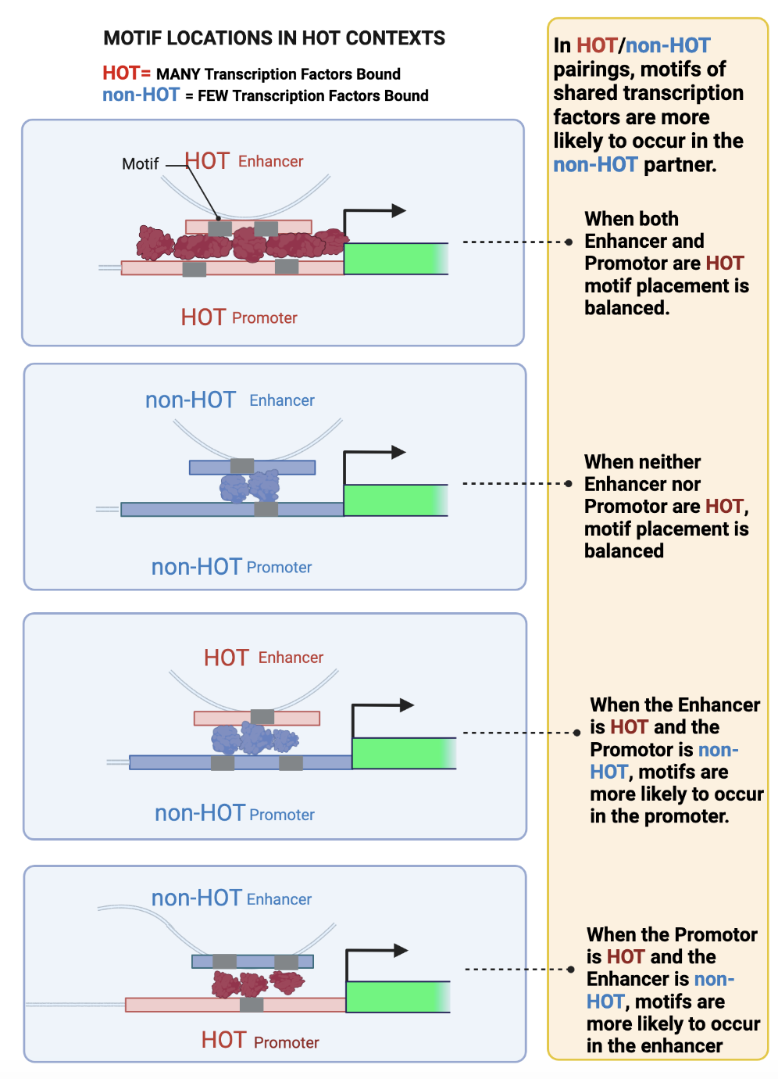
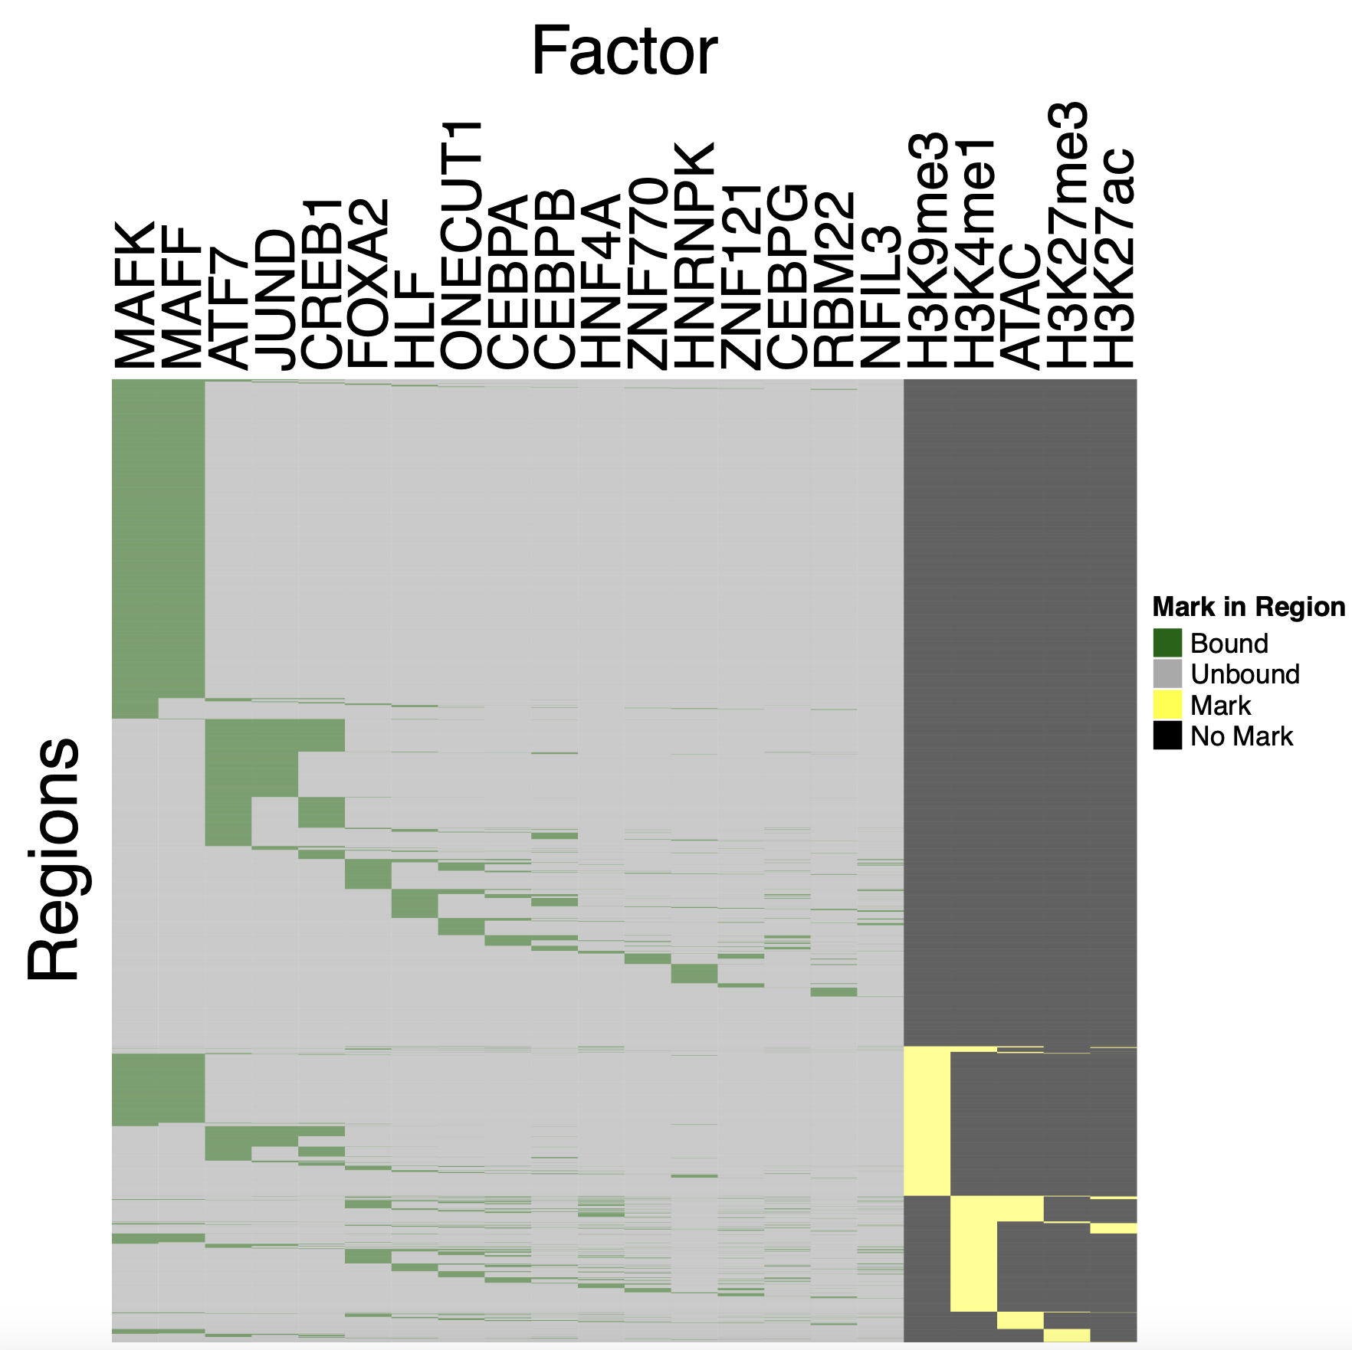
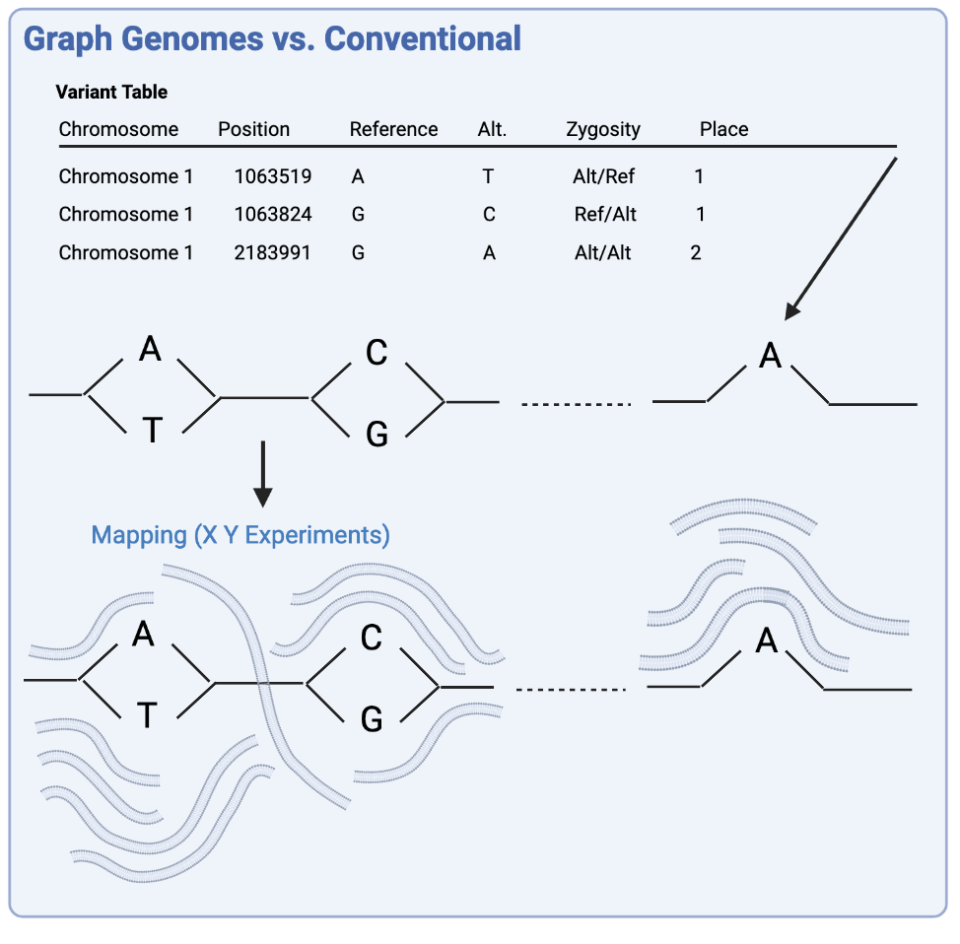
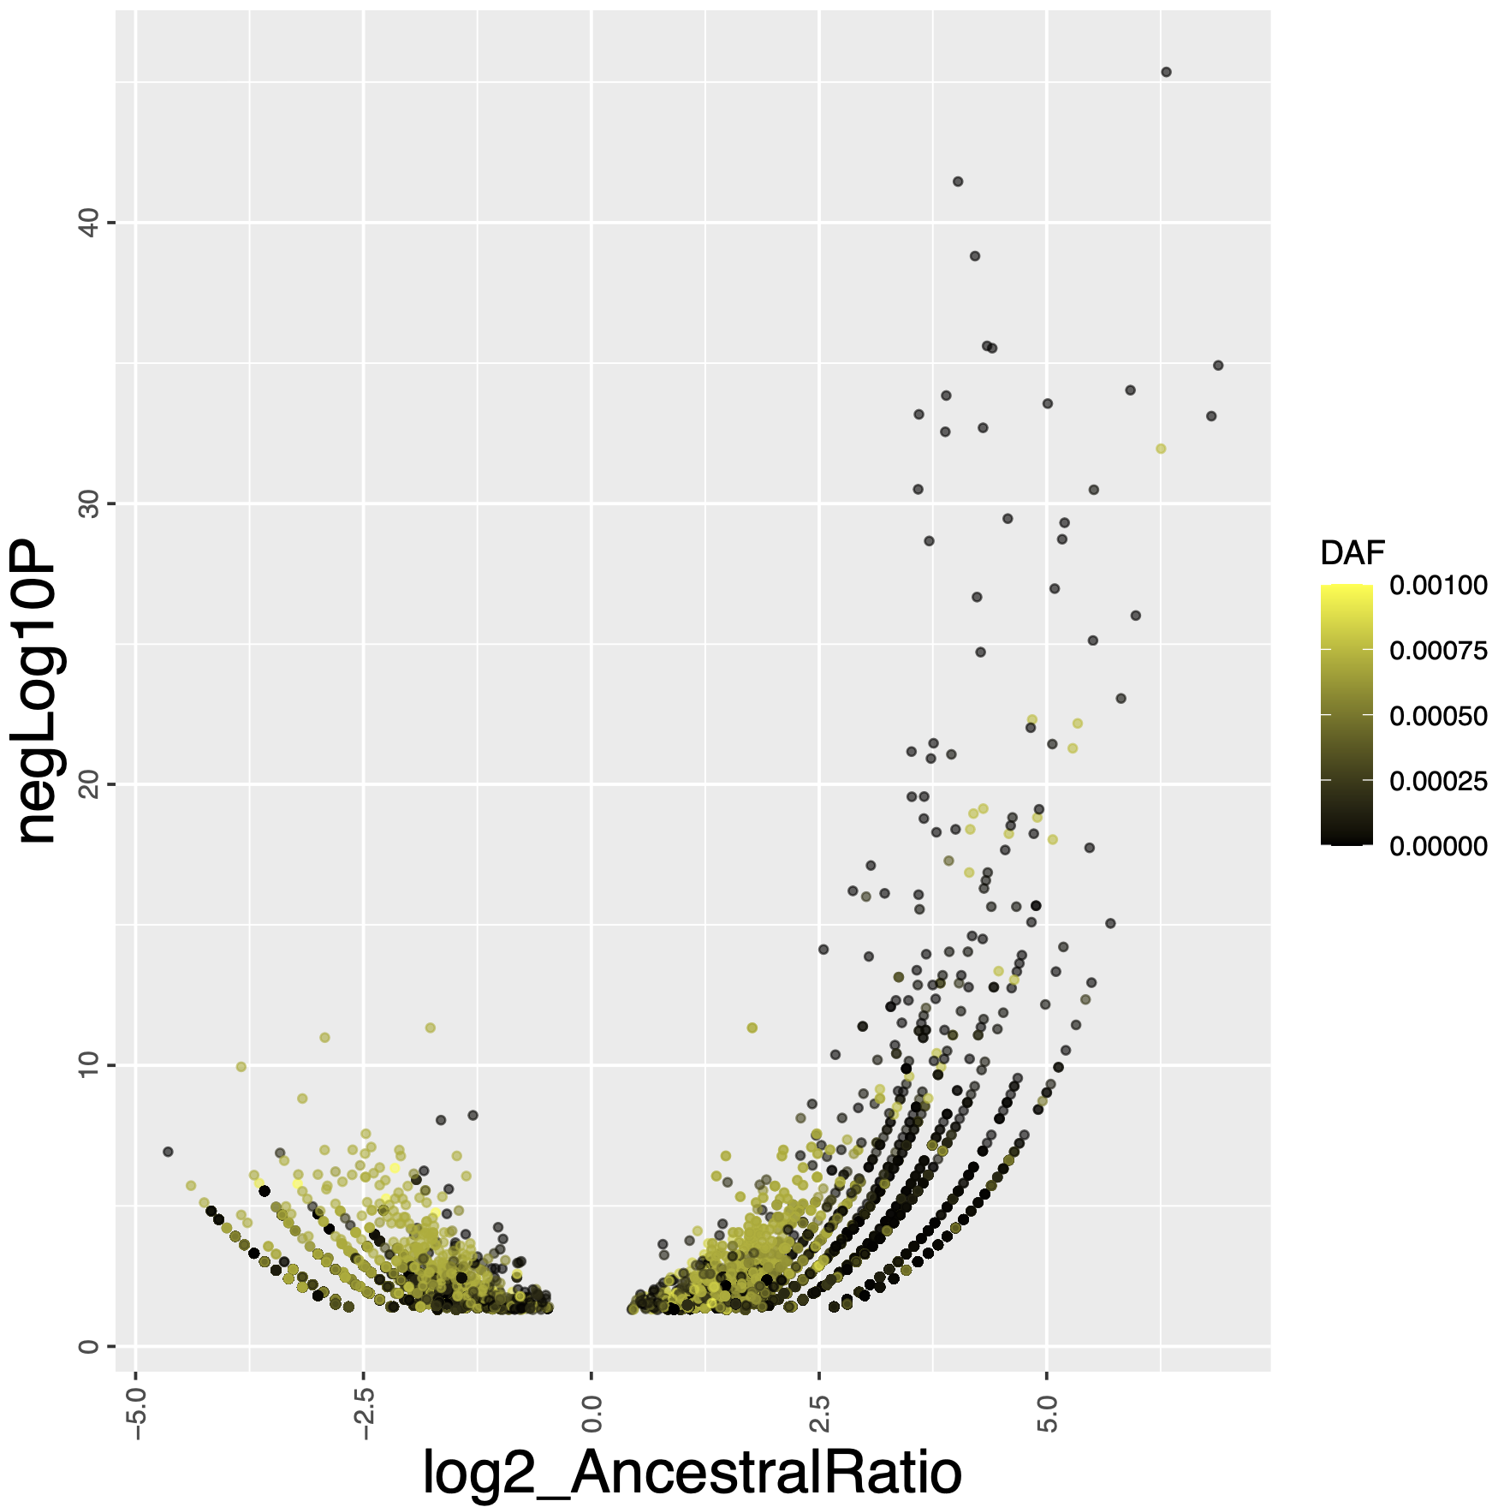
Summary
3D genome organization and TF binding
My research focuses on understanding non-coding DNA.
I focus on how TFs bind to DNA to affect gene transcription.
Many more research topics that we did not discuss
Some examples.
Broad genomic patterns of binding
Alternate ways to store genomes, and their applications
Cool evolutionary patterns in how TF binding changes

Slide 44
Bootcamp Intro

Slide 45
Goals
Hands-on lessons from the Software Carpentry in R
After today, we will be able to:
Read and manipulate data in the R programming language
Use programming concepts in R: Functions and For Loops *

Slide 46
Flow
Discuss concepts -> work exercises -> review together
Website has links to reading/example material: https://james-lawlor.github.io/biotrain-2023/
Asking questions = better experience for everyone
Live feedback with post-its:
Green post-it on computer: The pace is good and I’m keeping up
Red post-it on computer: I’d like a helper / Slow down!
Helpers: Experienced helpers are available for one-on-one help as we’re working

Slide 47
~ 10 minute Break

